Slide 1

Interview Preparation Application
60% Presentation
Group Members
Hozefa Hassan Rizvi (FA20-BSE-019)
Muhammad Hammad (FA20-BSE-031)
Ashar Ali(FA20-BSE-158)
Supervisor Name
Mam Sana Malik
Department of Computer Science
COMSATS University Islamabad, Abbottabad Campus

Slide 2
Agenda
Project Introduction
Project Scope
Functional Requirements
Non-Functional Requirements
Data Flow Diagram
Use Case Diagram
System Block Diagram
Summary of 30% Project Implementation
Schedule(Gantt Chart)

Slide 3
Project Introduction
“Interview preparation application” is a platform that provide an ease to candidates who want to prepare and boost up their confidence before appearing in an interview
This application is specifically for Software engineering graduates. We assume that they have enough knowledge of their field as we’re not providing textbooks content, we’re providing that data which help the candidate to successfully pass their interview

Slide 4
Project Scope
What to do:
Comprehensive Question Bank: We will develop an extensive database of interview questions and answers, covering various aspects of software engineering.
Expert Interaction: Users can connect with industry experts and successful candidates to seek guidance and advice.
Interview Performance Tracking: The app will allow users to track their interview preparation progress and identify areas for improvement.
User Contribution: We encourage active user participation, allowing them to contribute questions, answers, and insights to enrich the platform.

Slide 5
Project Scope
What to do:
Mock Interview Enhancement Tips: In addition to assessing the user's confidence level based on hand gestures, facial expressions, and eye movements, the app will provide recommendations on how to improve their confidence. These recommendations may include tips on body language, eye contact.
User Interaction with Questions and Answers: Within the Question Bank, users will have the ability to view questions and answers contributed by other users. They can also provide feedback and responses to these questions, fostering a collaborative and interactive learning environment.

Slide 6
Project Scope
What not to do:
Textbook Content: Our focus is on interview-specific content. We won't provide textbook-style educational material unrelated to interview preparation.
Job Placement Services: While we aim to improve employability, we won't directly offer job placement or recruitment services within the app.
Certifications: Our application doesn't provide certification programs; it's purely for interview preparation and skill development.
Specific to Software Engineering Graduates: The Interview Preparation Application is tailored exclusively for software engineering graduates and may not cater to the needs of candidates from other fields. Its content and resources are designed with a software engineering focus.

Slide 7
Functional Requirements
FR#1: Candidate shall authenticate their identity or create an account and set up their profile.
FR#2: Candidate shall be able to track their progress after completing a mock interview.
FR#3: Candidate shall perform mock interviews to assess and improve their non-verbal skills.
FR#4: Candidate shall have access to a question bank to study and practice interview questions.
FR#5: Candidate shall be able to interact with experts and seek guidance on interview preparation.
FR#6: Candidate shall be able to engage with the community to learn from others' experiences.
FR#7: The system should enable administrators to manage user accounts, monitor content, and ensure a positive user experience.

Slide 8
Non-Functional Requirements
Usability:
USR-1: The Interview Preparation Application shall have an intuitive and user-friendly
interface to facilitate easy navigation and access to features.
USR-2: Error messages and warnings should be presented in a user-friendly manner to
guide users in error recovery without confusion.
Performance:
PRF-1: The application should load Android devices within 10 seconds of clicking the
application icon.
PRF-2: The average response time for any user action within the application should not
exceed 1 second under normal load conditions.
PRF-3: The database should be able to handle at least 1000 concurrent users accessing
the application without any significant performance degradation

Slide 9
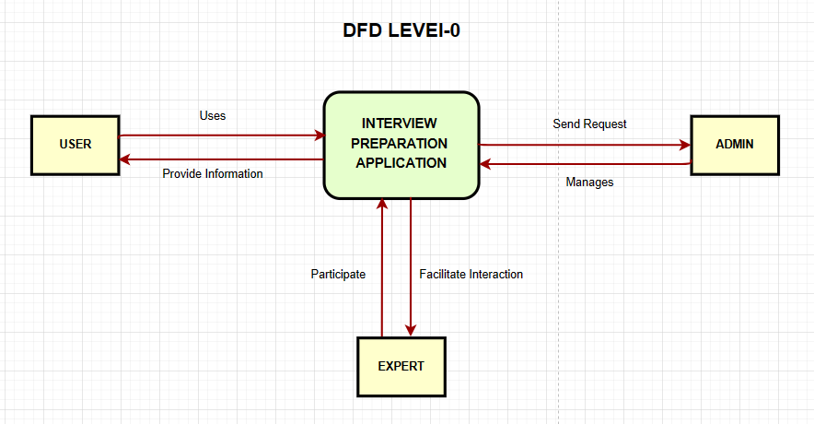
DFD (Level-0)

Slide 10
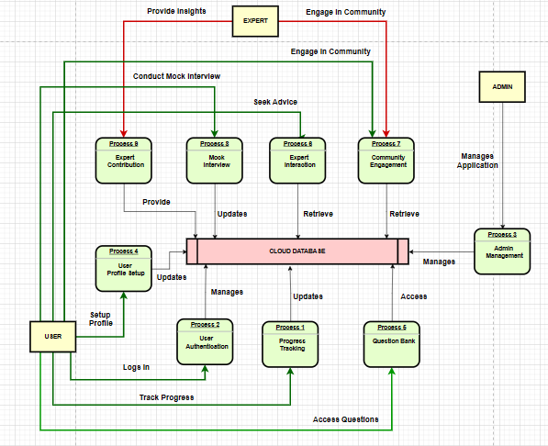
DFD (Level-1)

Slide 11
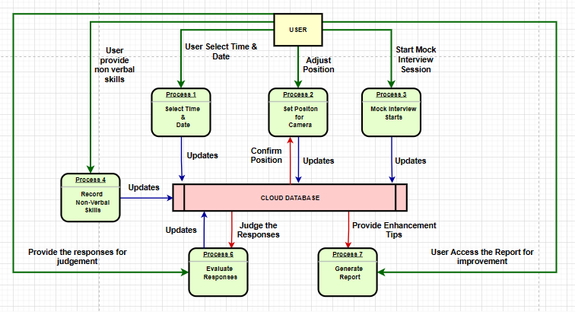
DFD (Level-2)

Slide 12
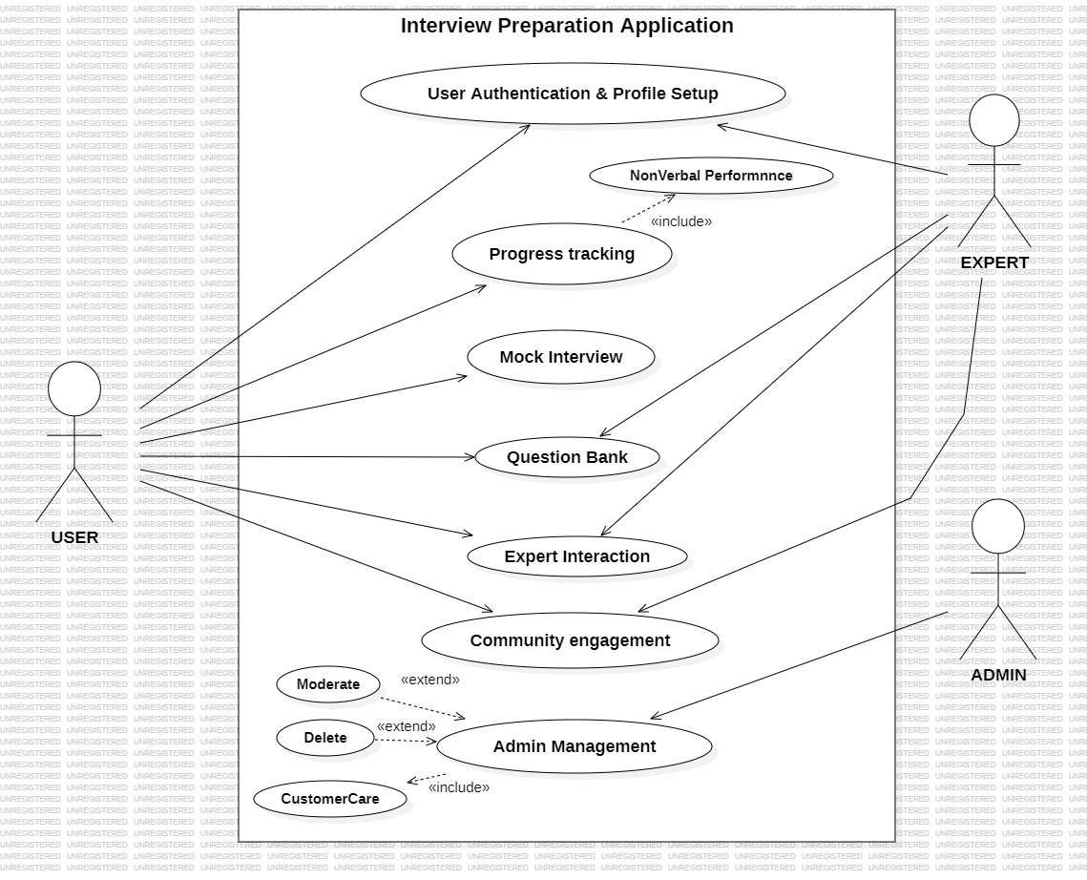
Use Cases Diagram

Slide 13
Summary of 30% Project Implementation
In 30% three sprints are completed:
Sprint Two
Software Requirement Specification Document (SRS)
Sprint Three
Software Design Document (SDD)
Application Design
Sprint Four
User Panel Development
Front End Development
Back End Development

Slide 14
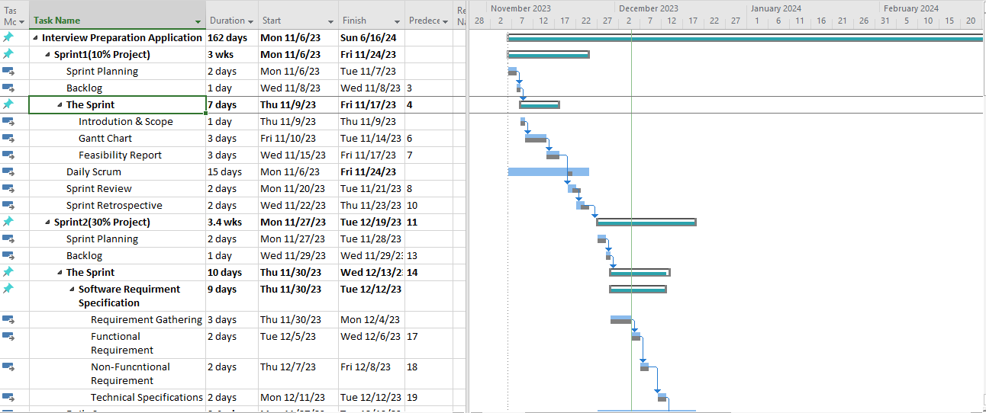
Gantt Chart

Slide 15
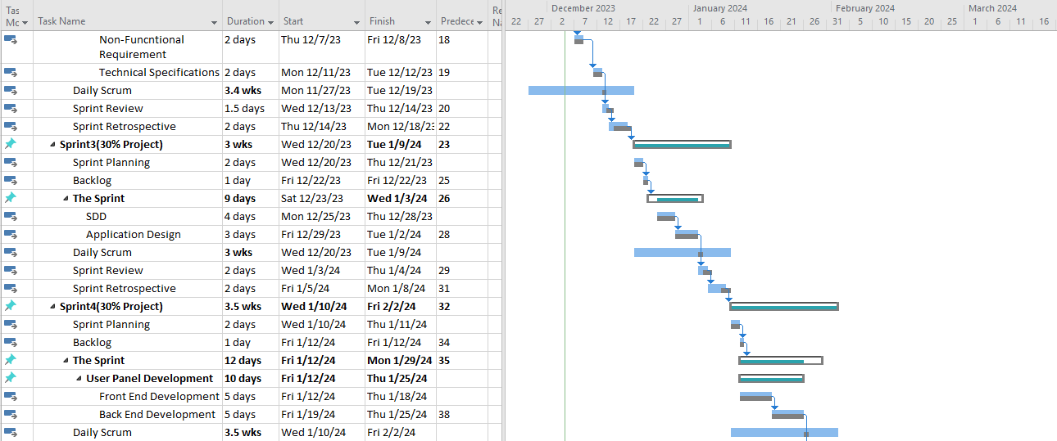
Gantt Chart

Slide 16
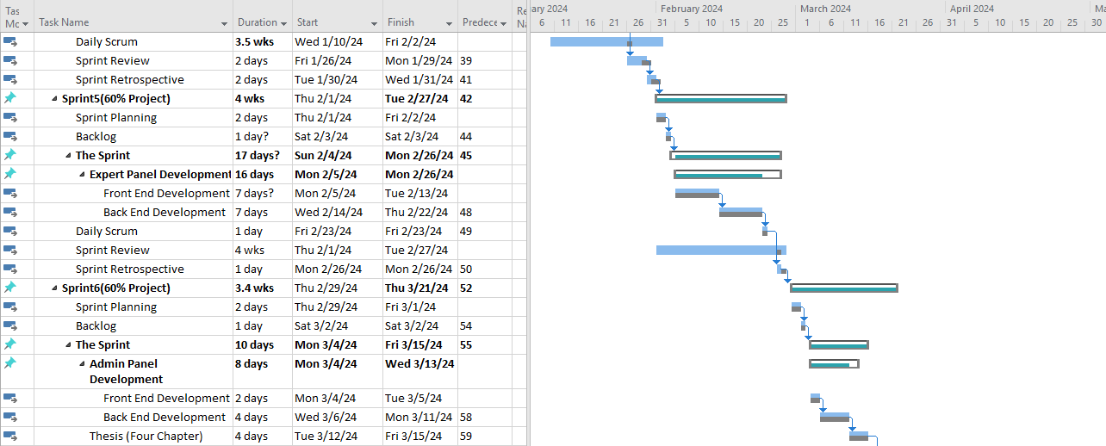
Gantt Chart

Slide 17
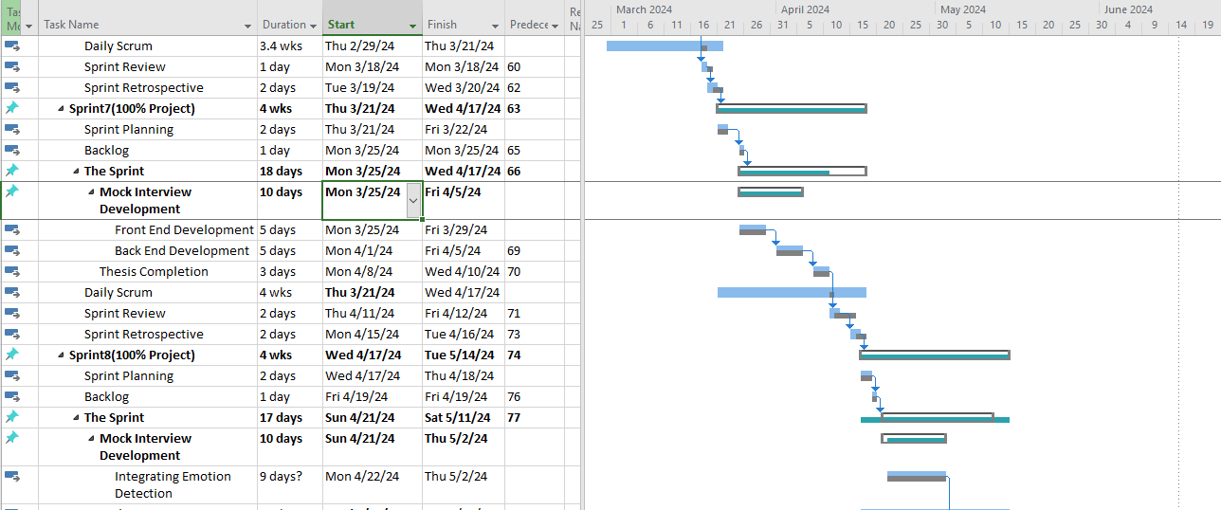
Gantt Chart

